Slide 1
Section 1.3
Complex Numbers
Quadratic Equations in the Complex Number System
Copyright © 2012 Pearson Education, Inc. Publishing as Prentice Hall.

Slide 2



Copyright © 2012 Pearson Education, Inc. Publishing as Prentice Hall.

Slide 3
Copyright © 2012 Pearson Education, Inc. Publishing as Prentice Hall.

Slide 4

Copyright © 2012 Pearson Education, Inc. Publishing as Prentice Hall.

Slide 5



Copyright © 2012 Pearson Education, Inc. Publishing as Prentice Hall.

Slide 6

a) (3 – 2i) + (5 – 4i)
b) (3 – 2i) – (5 – 4i)
(3+5) + [(–2) +(– 4)] i
(3 – 5) + [(–2) –(– 4)] i
8–6 i
–2+2 i
Copyright © 2012 Pearson Education, Inc. Publishing as Prentice Hall.

Slide 7

(3 – 2i) (5 – 4i)
3(5) +3(– 4i)+(– 2i)(5)+(– 2i)(– 4i)
15 – 12i – 10i + 8i²
= 15 – 22i +8(–1)
= 7 – 22i
Copyright © 2012 Pearson Education, Inc. Publishing as Prentice Hall.

Slide 8
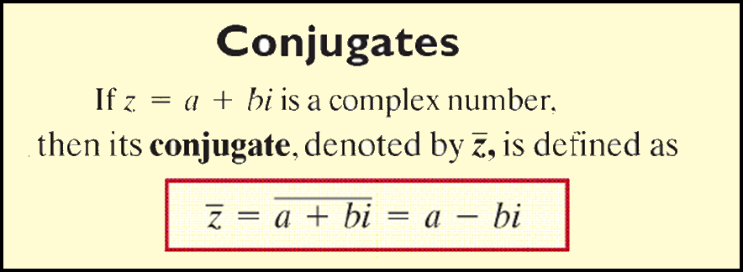
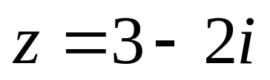
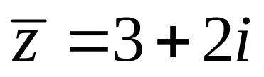
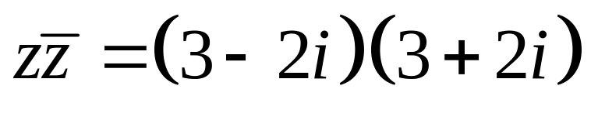
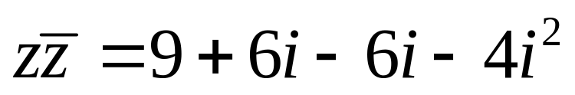
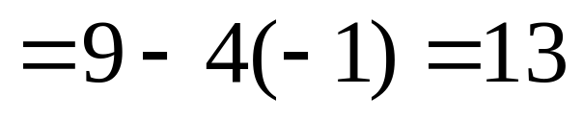
Copyright © 2012 Pearson Education, Inc. Publishing as Prentice Hall.

Slide 9

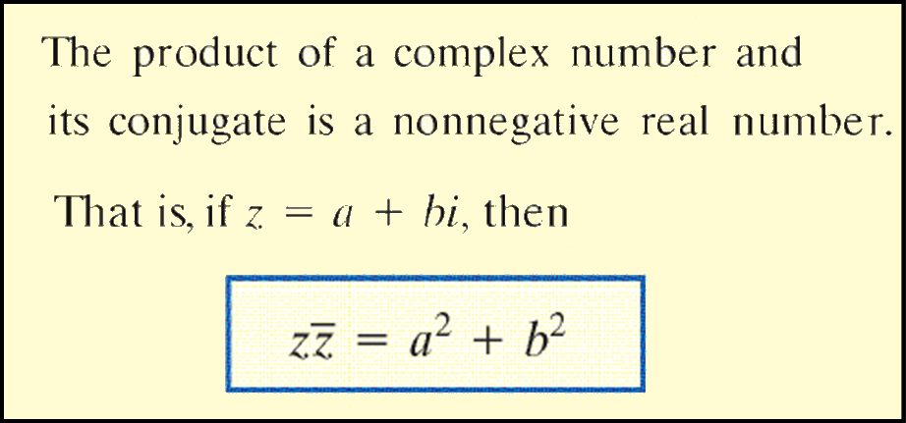
Copyright © 2012 Pearson Education, Inc. Publishing as Prentice Hall.

Slide 10
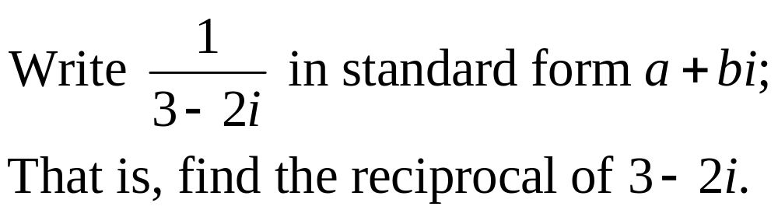
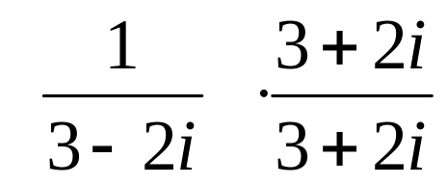
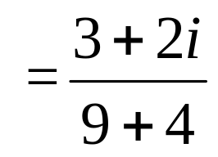
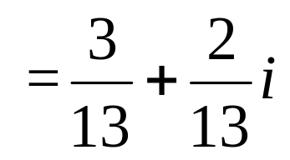
Copyright © 2012 Pearson Education, Inc. Publishing as Prentice Hall.

Slide 11
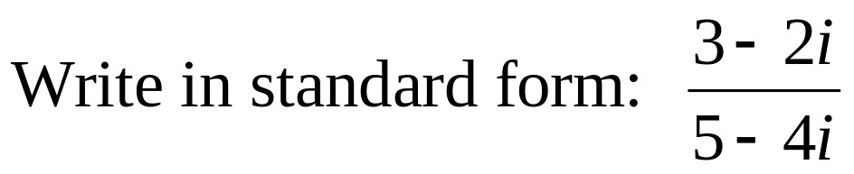
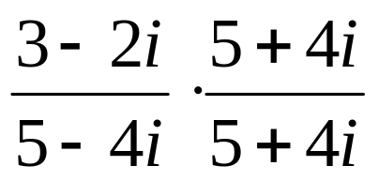
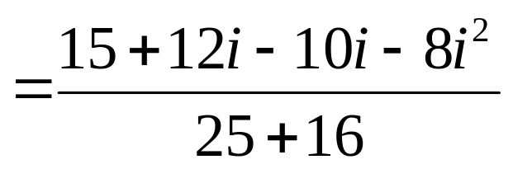
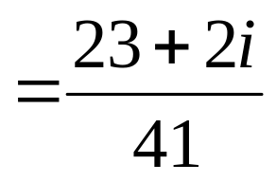
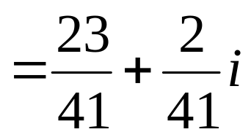
Copyright © 2012 Pearson Education, Inc. Publishing as Prentice Hall.

Slide 12
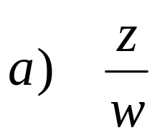
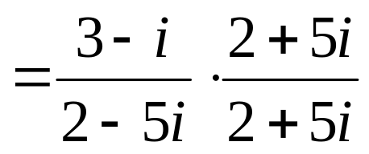
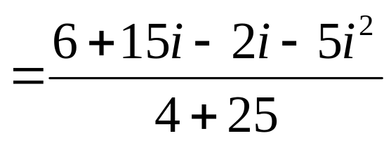
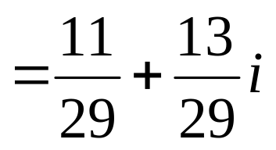
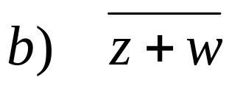
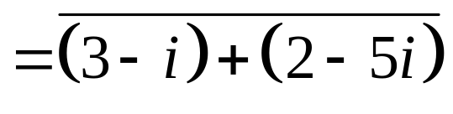
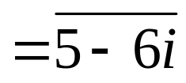


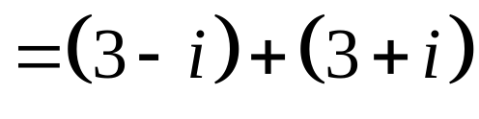

Copyright © 2012 Pearson Education, Inc. Publishing as Prentice Hall.

Slide 13

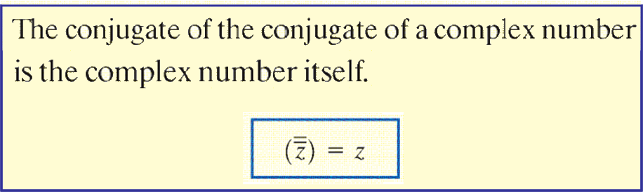
Copyright © 2012 Pearson Education, Inc. Publishing as Prentice Hall.

Slide 14
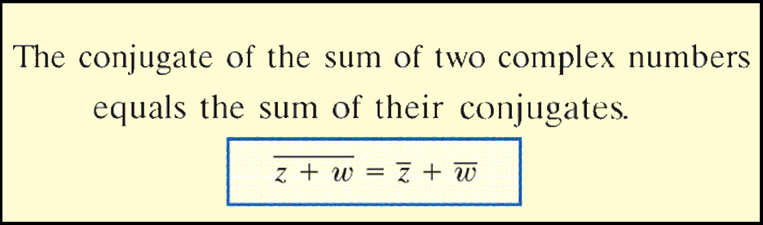
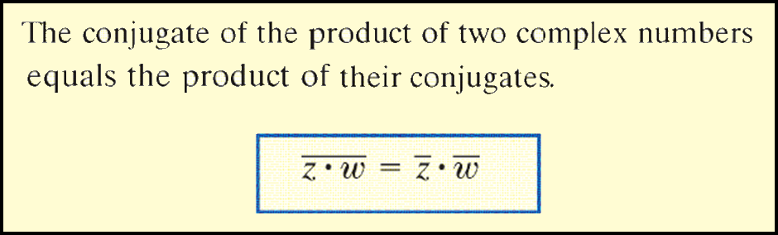
Copyright © 2012 Pearson Education, Inc. Publishing as Prentice Hall.

Slide 15

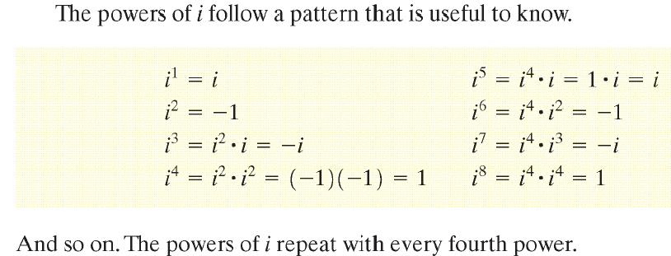

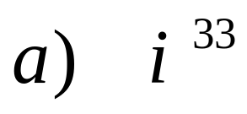
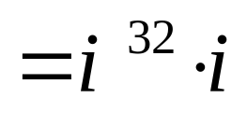
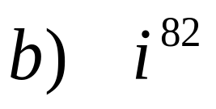
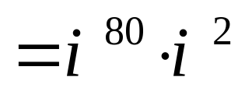
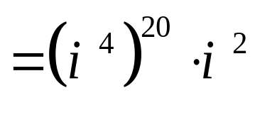
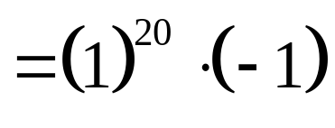
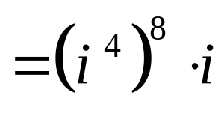
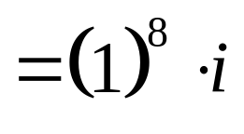


Copyright © 2012 Pearson Education, Inc. Publishing as Prentice Hall.

Slide 16





Copyright © 2012 Pearson Education, Inc. Publishing as Prentice Hall.

Slide 17
Copyright © 2012 Pearson Education, Inc. Publishing as Prentice Hall.

Slide 18
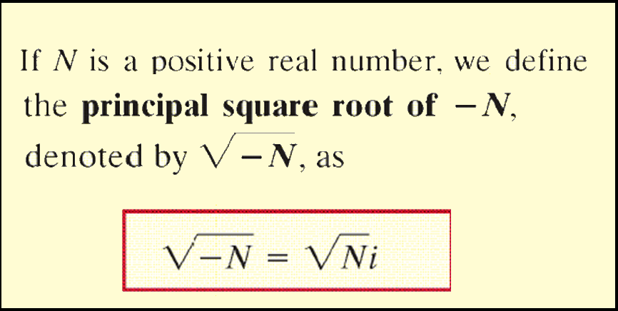
Copyright © 2012 Pearson Education, Inc. Publishing as Prentice Hall.

Slide 19
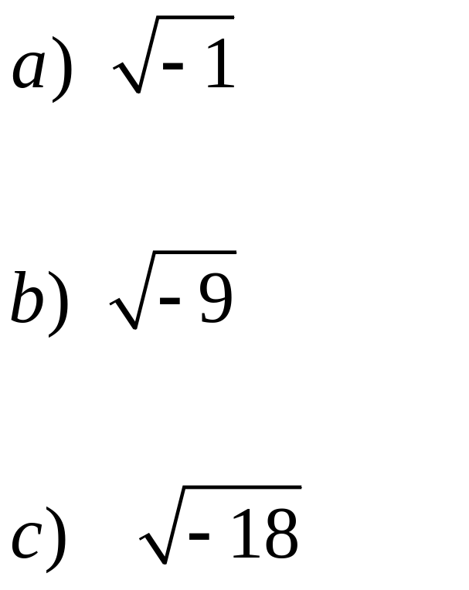
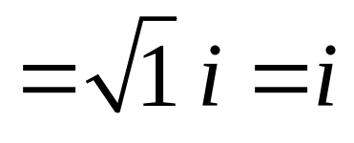
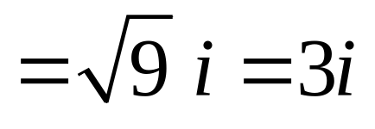
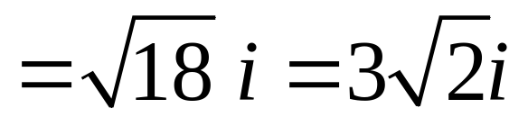
Copyright © 2012 Pearson Education, Inc. Publishing as Prentice Hall.

Slide 20

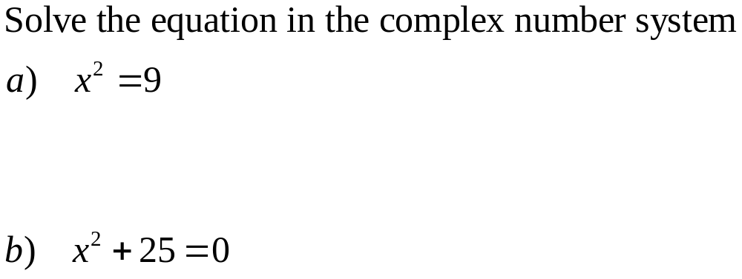
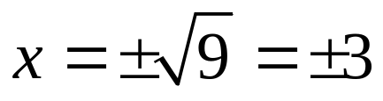
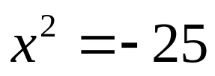
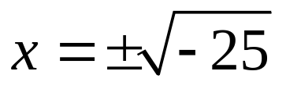
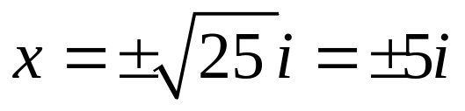
Copyright © 2012 Pearson Education, Inc. Publishing as Prentice Hall.

Slide 21

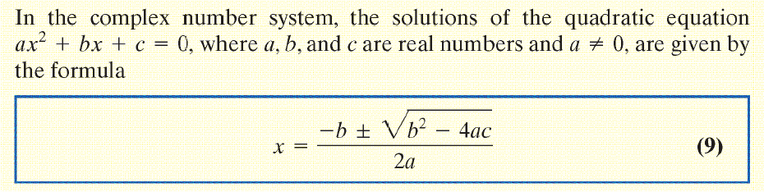
Copyright © 2012 Pearson Education, Inc. Publishing as Prentice Hall.

Slide 22
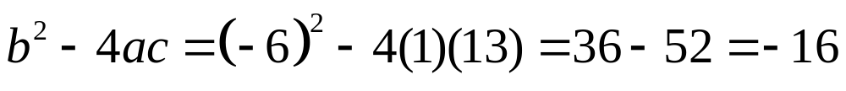
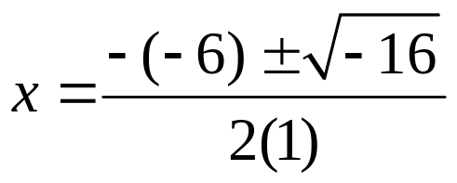
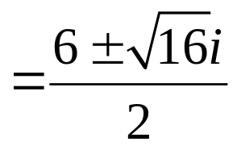


Copyright © 2012 Pearson Education, Inc. Publishing as Prentice Hall.

Slide 23

Copyright © 2012 Pearson Education, Inc. Publishing as Prentice Hall.

Slide 24






Copyright © 2012 Pearson Education, Inc. Publishing as Prentice Hall.

